Slide 1
First-Order Methods

Slide 2
Gradient Descent
Search in direction of steepest descent

Slide 3
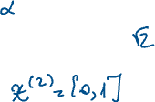


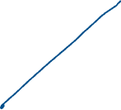







Slide 4
Gradient Descent
Applying gradient descent
and line search on Rosenbrock
function

Slide 5
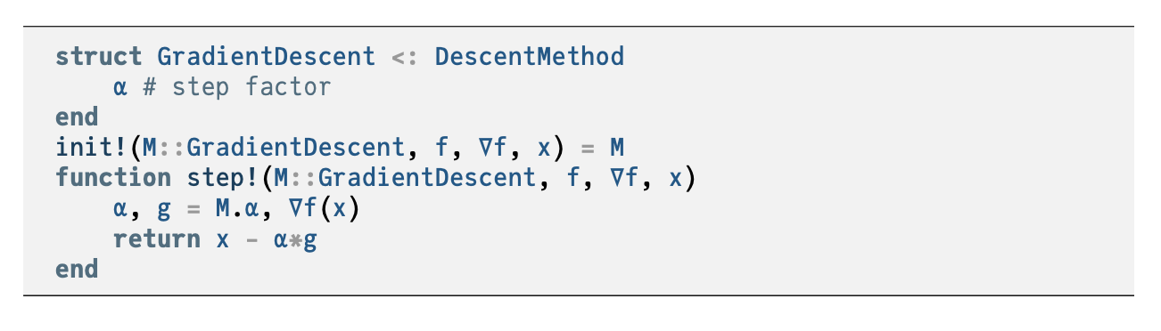

Slide 6
Momentum
Addresses common convergence issues
Some functions have regions with very small gradients

Slide 7
Momentum
Momentum update equations

Slide 8
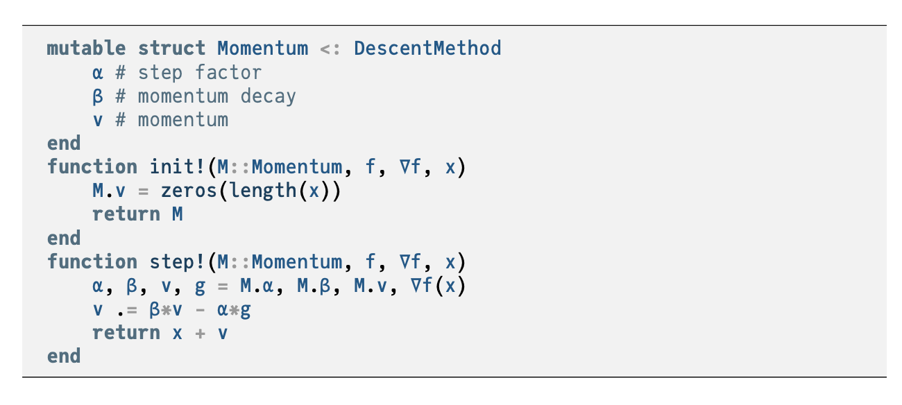

Slide 9



Momentum
Some functions cause gradient descent to get stuck
Momentum overcomes these issues by replicating the effect of physical momentum

Slide 10

Nesterov Momentum

Slide 11






Adagrad
Instead of using the same learning rate for all components of x, Adaptive Subgradient method (Adagrad) adapts the learning rate for each component of x.
For each component of x, the update equation is
where
$$ϵ≈1×{10}^{−8}$$

